Slide 1
Chapter 2
Managers
and Management
PowerPoint Presentation by Charlie Cook
Copyright © 2004 Prentice Hall, Inc.
All rights reserved.

Slide 2
L E A R N I N G O U T C O M E S
After reading this chapter, I will be able to:
Describe the difference between managers and operative employees.
Explain what is meant by the term management.
Differentiate between efficiency and effectiveness.
Describe the four primary processes of management.
Classify the three levels of managers and identify the primary responsibility of each group.
Copyright © 2004 Prentice Hall, Inc. All rights reserved.
1–<number>

Slide 3
L E A R N I N G O U T C O M E S (cont’d)
After reading this chapter, I will be able to:
Summarize the essential roles performed by managers.
Discuss whether the manager’s job is generic.
Describe the four general skills necessary for becoming a successful manager.
Copyright © 2004 Prentice Hall, Inc. All rights reserved.
1–<number>

Slide 4
Organizations
Organization
  A systematic arrangement of people brought together to accomplish some specific purpose; applies to all organizations—for-profit as well as not-for-profit organizations.
  Where managers work (manage)
  Our university is an organization, football team
1–<number>

Slide 5
Managers
Are the individuals in an organization who direct and oversee the activities of other people in the organization so that organizational goals can be accomplished.
Copyright © 2004 Prentice Hall, Inc. All rights reserved.
1–<number>

Slide 6
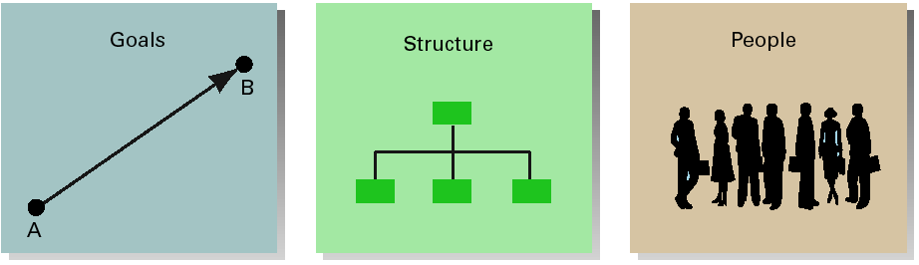
Common Characteristics of Organizations
Copyright © 2004 Prentice Hall, Inc. All rights reserved.
EXHIBIT 1.1
1–<number>

Slide 7
Common characteristics
  Goals : every organization has a purpose
  Structure : all organizations develop a systematic structure that defines and limits the behavior of its members
    Developing a structure may include creating rules and regulations, giving members supervisory control, forming teams, etc.
  People : purposes can only be achieved through people
Copyright © 2004 Prentice Hall, Inc. All rights reserved.
1–<number>

Slide 8

People Differences
Operatives (non-managerial employees)
  People who work directly on a job or task and have no responsibility for overseeing the work of others
Managers
  Individuals in an organization who direct the activities of others
    Some managers also have operative responsibilities themselves.
Copyright © 2004 Prentice Hall, Inc. All rights reserved.
1–<number>

Slide 9
Operatives and managers distinction
  is that managers have employees who report directly to them.
Copyright © 2004 Prentice Hall, Inc. All rights reserved.
1–<number>

Slide 10
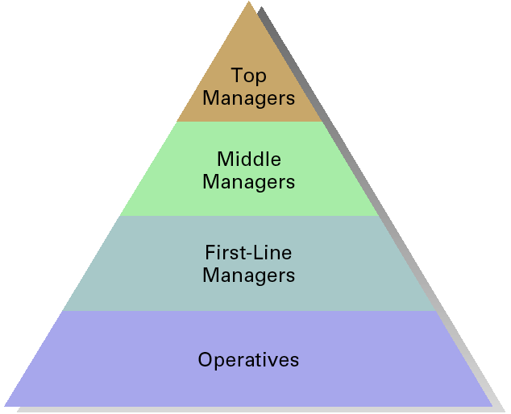
Organizational Levels
Copyright © 2004 Prentice Hall, Inc. All rights reserved.
EXHIBIT 1.2
1–<number>

Slide 11
Identifying Managers
First-line managers
  Supervisors responsible for directing the day-to-day activities of operative employees
    First-line managers are called supervisors.
      Team leaders, coaches, unit coordinators
Copyright © 2004 Prentice Hall, Inc. All rights reserved.
1–<number>

Slide 12
Middle managers
  Individuals at levels of management between the first-line manager and top management
    Translate the goals set by top management into specific details that lower managers can perform
      Department head, project leader, unit chief, district manager, dean, division manager
Copyright © 2004 Prentice Hall, Inc. All rights reserved.
1–<number>

Slide 13
Top managers
  Individuals who are responsible for making decisions about the direction of the organization and establishing policies that affect all organizational members
      Vice persident, president, managing director, chief operating officer, chief executive officer CEO, chairperson of the board
Copyright © 2004 Prentice Hall, Inc. All rights reserved.
1–<number>

Slide 14
Management Defined
Managers regardless of their title or role share common elements
Management refers to
  The process of getting things done, effectively and efficiently, through and with other people
  Efficiency
    Means doing the thing correctly; refers to the relationship between inputs and outputs; seeks to minimize resource costs
      Input resources; money, people, equipment
  Effectiveness
    Means doing the right things; completing activities; goal attainment
1–<number>

Slide 15
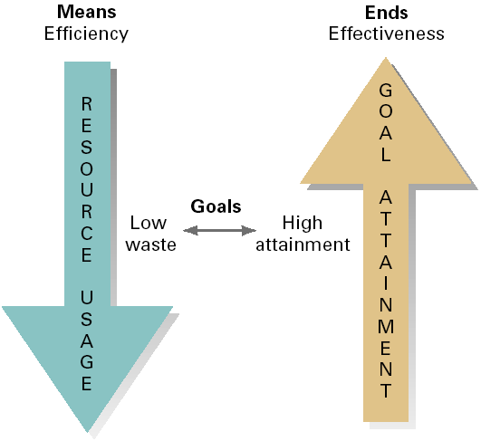
Efficiency and Effectiveness
Copyright © 2004 Prentice Hall, Inc. All rights reserved.
EXHIBIT 1.3
1–<number>

Slide 16
What managers do?
  Functions
  Roles
  Skills / competencies
Copyright © 2004 Prentice Hall, Inc. All rights reserved.
1–<number>

Slide 17
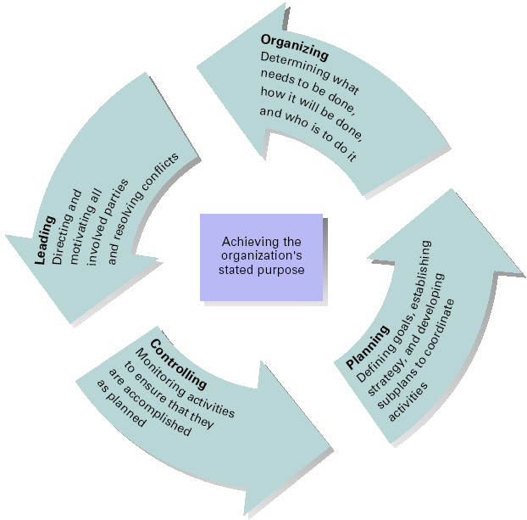
Management
Process
Activities
Management process:
planning, organizing, leading, and controlling
Copyright © 2004 Prentice Hall, Inc. All rights reserved.
EXHIBIT 1.4
1–<number>

Slide 18

Management Process
Planning
  Includes defining goals, establishing strategy, and developing plans to coordinate activities
  Setting goals
Organizing
  Includes determining what tasks
  to be done, who is to do them,
  how the tasks are to be
  grouped, who reports to
  whom, and where
  decisions are to be made
Copyright © 2004 Prentice Hall, Inc. All rights reserved.
1–<number>

Slide 19

Management Process
Leading
  Includes motivating employees, directing the activities of others, selecting the most effective communication channel, and resolving conflicts
Controlling
  The process of monitoring performance,
  comparing it with goals, and
  correcting any significant
  deviations
Copyright © 2004 Prentice Hall, Inc. All rights reserved.
1–<number>

Slide 20
Mintzberg’s Managerial Roles
In 1960’s, Henry Mintzberg found
  Managers engaged in large number of varied, unpatterned, and short-duration activities.
  Little time for thinking (due to interruptions)
  Activities < 9 minutes
Copyright © 2004 Prentice Hall, Inc. All rights reserved.
1–<number>

Slide 21
Mintzberg’s Managerial Roles
Interpersonal relationships
  Figurehead
  symbolic head; greeting visitors, signing legal documents
  Leader
  performing virtually all activities that involve employees
  Liaison
  Maintains self-developed network of outside contacts and informs who provide favors and information
Source: Adapted from The Nature of Managerial Work (paperback) by H. Mintzberg, Table 2, pp.92–93. Copyright © 1973 Addison Wesley Longman. Reprinted by permission of Addison Wesley Longman.
EXHIBIT 1.5
Copyright © 2004 Prentice Hall, Inc. All rights reserved.
1–<number>

Slide 22
Mintzberg’s Managerial Roles
Informational
  Monitor
  Emerges as nerve center of internal and external information about the organization
  Disseminator
  Transmits information received from other employees to members of the organization
  Spokesperson
  Transmits information to outsiders on organization’s plans, policies, actions, results
Copyright © 2004 Prentice Hall, Inc. All rights reserved.
1–<number>

Slide 23
Mintzberg’s Managerial Roles
Decisional
  Entrepreneur
  Searches organization and its environment for opportunities and initiates improvement projects to bring about change
  Disturbance handler
  Responsible for corrective action when organization faces crises, disturbances
  Resource allocator
  Responsible for allocation of organizational resources
  Negotiator
  Participating in union contract negotiations or with suppliers
Copyright © 2004 Prentice Hall, Inc. All rights reserved.
1–<number>

Slide 24
Is The Manager’s Job Universal?
Level in the organization
  Do managers manage differently based on where they are in the organization?
    Managerial roles are changing but not activity.
    Top-managers design overall organization structure, lower-level managers design the jobs of individuals and work groups
Profit versus not-for-profit (nonprofit)
  Is managing in a commercial enterprise different than managing in a non-commercial organization?
    Performance of museums, government agencies, charitable organizations
    All managers make decisions, set objectives, create workable organization structure, hire and motivate employees, secure legitimacy for their organization’s existence, and develop internal political support to apply plans
    Profit for ‘owners’, performance of profit maximizing market test
1–<number>

Slide 25
Size of organization
  Does the size of an organization affect how managers function in the organization?
    Size; number of employees, annual sales, total assets
    Small business < 500 employees, independently owned
    A small business manager is a generalist
    Large firm manager’s job is more structured and formal
Management concepts and national borders
  Is management the same in all economic, cultural, social and political systems?
  The concepts will be discussing in future chapters apply to free-market democracies United-States, Canada, Great Britain, Australia; english speaking countries
  India, China, Chile
Copyright © 2004 Prentice Hall, Inc. All rights reserved.
1–<number>

Slide 26
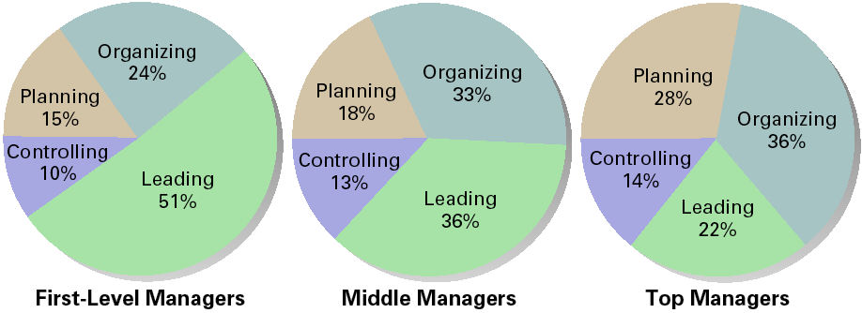
Distribution of Time per Activity by Organizational Level
Source: Adapted from T. A. Mahoney, T. H. Jerdee, and S. J. Carroll, “The Job(s) of Management,” Industrial Relations 4, No.2 (1965), p.103.
EXHIBIT 1.6
Copyright © 2004 Prentice Hall, Inc. All rights reserved.
1–<number>

Slide 27
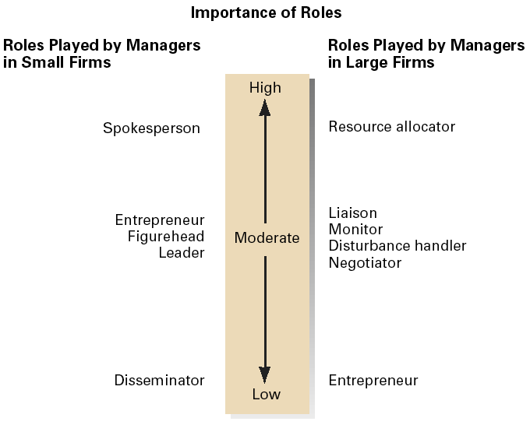
Importance of Managerial Roles in Small and Large Businesses
Source: Adapted from J. G. P. Paolillo, “The Manager’s Self Assessments of Managerial Roles: Small vs. Large Firms,” American Journals of Small Business, January–March 1984, pp.61–62.
EXHIBIT 1.7
Copyright © 2004 Prentice Hall, Inc. All rights reserved.
1–<number>

Slide 28
General Skills for Managers
Conceptual skills
  A manager’s mental ability to coordinate all of the organization’s interests and activities
Interpersonal skills
  A manager’s ability to work with, understand, mentor, delegate and motivate others, both individually and in groups
Technical skills
  Job specific knowledge and techniques needed to perform work tasks
Political skills
  A manager’s ability to build a power base and establish the right connections
  Political arena
1–<number>

